Slide 1
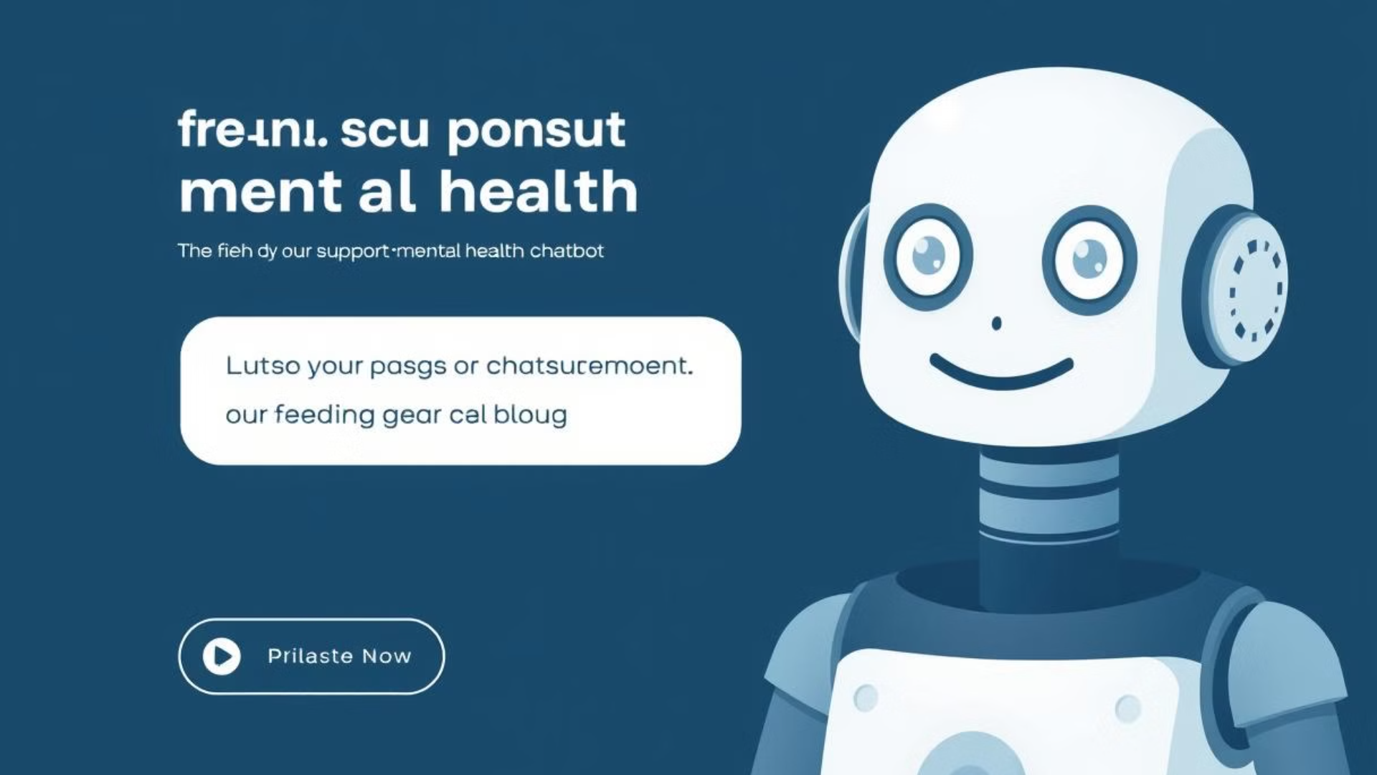
Mental Health Chatbot
Using
Machine Learning

Slide 2

Problem Statement
Hesitation to Seek Professional Help: Many people hesitate to seek professional help for mental health struggles.
Social Stigma: Social stigma often makes individuals feel ashamed or judged for reaching out to a therapist.
Perceived Severity of Problems: Some people feel that their problems aren’t “serious enough” to justify therapy.
Access to Care: Others may not have access to affordable or timely mental health care.
Informal Coping Mechanisms: Many choose to bottle up their emotions or turn to informal ways of coping.
Growing Interest in Support: There's a growing interest in finding ways to support emotional well-being, even through small, simple tools.

Slide 3






Working Mechanism Overview
User Input
1
User Input
User types a message (e.g., “I feel exhausted…”)
Text Preprocessing
2
Text Preprocessing
Clean text: remove symbols, links, lowercasing, etc.
Sentiment Prediction
3
Sentiment Prediction
Logistic Regression model predicts: Positive or Negative
Response Generation
4
Response Generation
Based on prediction, choose a predefined supportive or cheerful message
Chatbot Output
5
Chatbot Output
Final message shown to the user (e.g., “I'm sorry you're feeling this way. You're not alone.”)

Slide 4

Tools and Technologies Used
Python: Core programming language for the project
Jupyter Notebook: For development and experimentation
Pandas: For data handling and preprocessing
Scikit-learn:
TF-IDF vectorization
Logistic Regression model
Naive Bayes comparison
Model evaluation
Numpy: Support for numerical operations
Pickle: To save the trained model and vectorizer
Matplotlib: For visualizing evaluation metrics
Streamlit: For building a simple chatbot interface

Slide 5

Dataset
Dataset used: Sentiment140
Why this dataset?
Real-world, informal text — like how people talk in chat
Large volume of data makes it suitable for training ML models
Easy to work with for binary sentiment classification (positive vs negative)
Other Datasets We Explored:
GoEmotions: 58k Reddit comments labeled with 27 emotion categories
EmpatheticDialogues: Conversations labeled with emotion + empathy

Slide 6

Data Preprocessing
Text Cleaning Removed URLs(https://…), mentions(@user), hashtags(#topic), punctuation, and special characters to reduce noise and focus on relevant text.
Lowercasing Converted all text to lowercase for consistency and to treat words with different casing as the same.
Tokenization Split the text into individual words or tokens to prepare for vectorization.
Stop Word Removal Removed common English words (e.g., "the," "is," "are") that don't contribute much to sentiment analysis.
Example: Original: "I'm feeling so down today... @friend #sad 😔" Cleaned: "im feeling so down today"

Slide 7

Model Training
Chosen Model: Logistic Regression
Simple and effective for binary classification
Works well with high-dimensional text data (like TF-IDF vectors)
Fast to train and doesn’t require heavy computing power.
Results:
Precision
Recall
F1-Score
Support
Negative
0.80
0.78
0.79
159494
Positive
0.79
0.81
0.80
160506
Accuracy
0.79
320000
Macro Avg
0.79
0.79
0.79
320000
Weighted Avg
0.79
0.79
0.79
320000

Slide 8

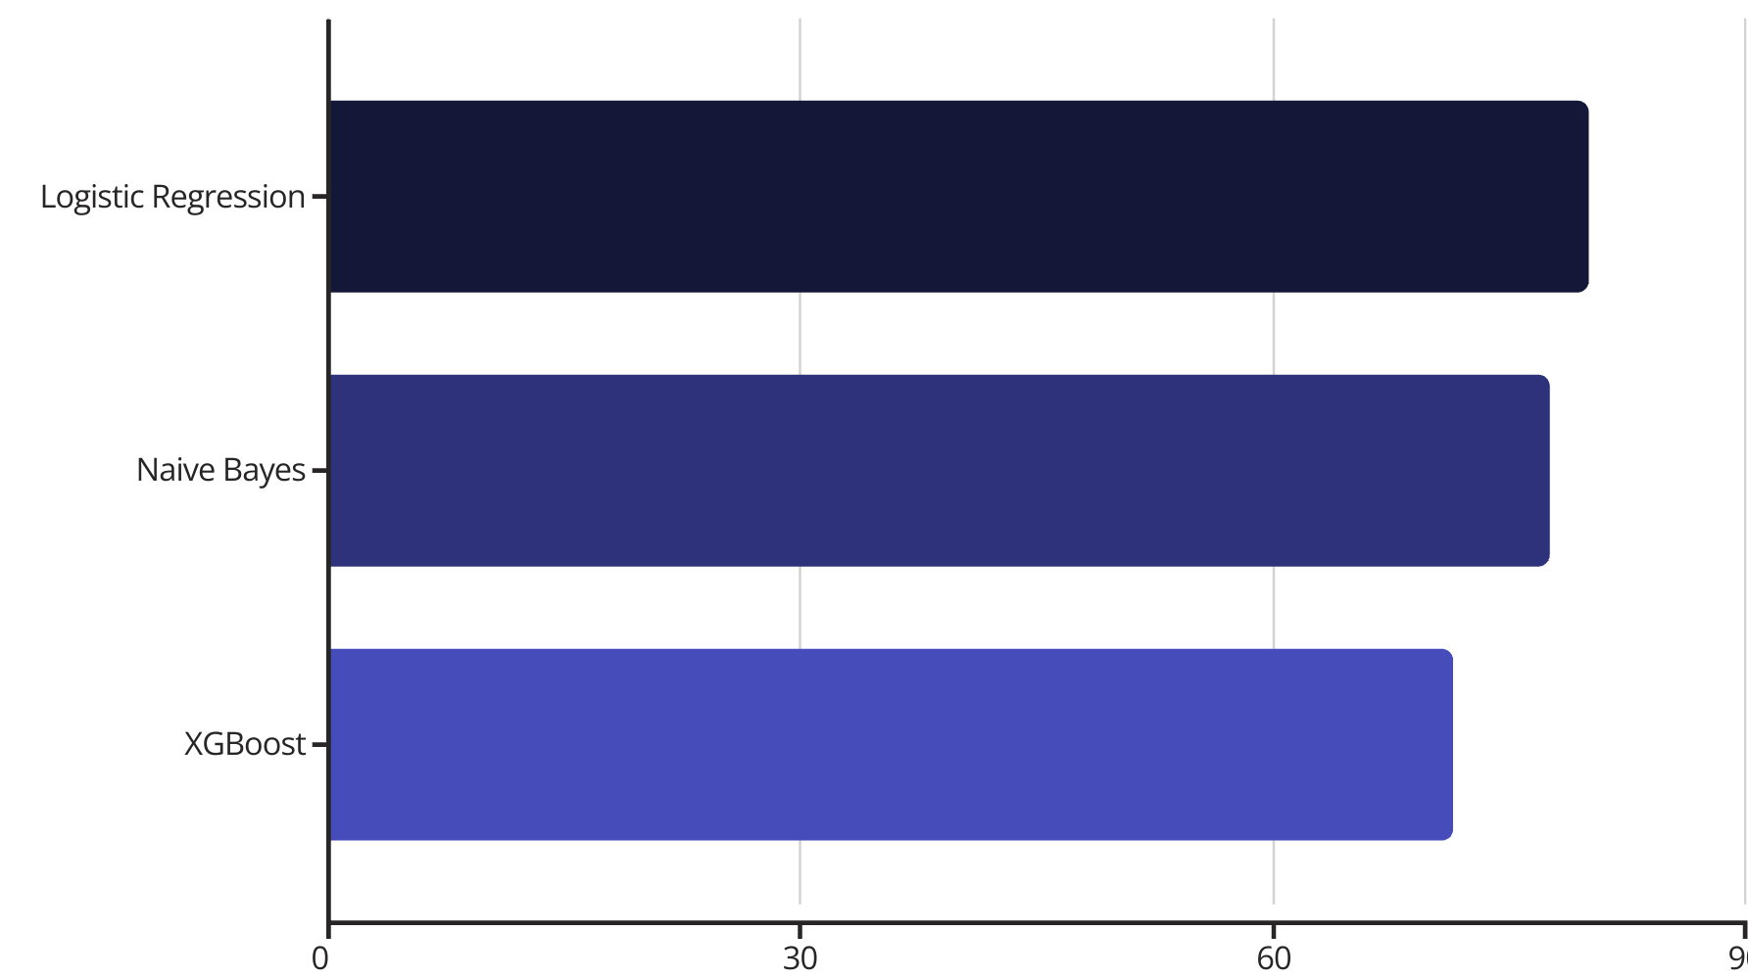
Model Comparison
Accuracy comparison of different models used for sentiment analysis.
The horizontal bar chart displays the accuracy of each model. Logistic Regression achieves the highest accuracy, followed by Naive Bayes and XGBoost.

Slide 9

Challenges Faced
1
Text Cleaning & Preprocessing
2
Choosing the Right Dataset
3
Model Selection
Testing different models and tuning parameters was time-consuming; needed to choose something simple yet effective.
Maintaining important context while cleaning too much.
Had to balance dataset complexity with project scope.
4
Limited Emotional Depth
5
Time & Resource Constraints
Model detects only positive/negative — doesn't truly "understand" emotion, making it hard to personalize chatbot responses or make them empathetic.
Limited computing power and time for experimenting with deep learning.

Slide 10

Future Improvements
Use More Relevant Datasets: Instead of just positive/negative, train the model on datasets of actual mental health conversations with fine-grained emotion labels (e.g., sadness, anger, joy)
Deep Learning Models: Explore advanced models like LSTM or BERT for better understanding of context and emotion
Dynamic Responses: Instead of fixed replies, generate more context-aware, personalized messages using NLP techniques
Multilingual Support: Extend the chatbot to understand and respond in regional languages
User Feedback Loop: Allow users to give feedback (like 👍 / 👎) to help the model improve over time

Slide 11

Conclusion
Gained hands-on experience in building a sentiment-based chatbot using machine learning.
Explored multiple datasets and compared various models.
Understood the critical role of data preprocessing in Natural Language Processing tasks.
Logistic Regression proved effective for binary sentiment classification using TF-IDF features.
Laid the foundation for more advanced emotion-aware systems.
Understood both the technical and real-world aspects of building supportive AI tools.

